Slide 1
Adaptive MPI
© 2018 L. V. Kale at the University of Illinois Urbana

Slide 2
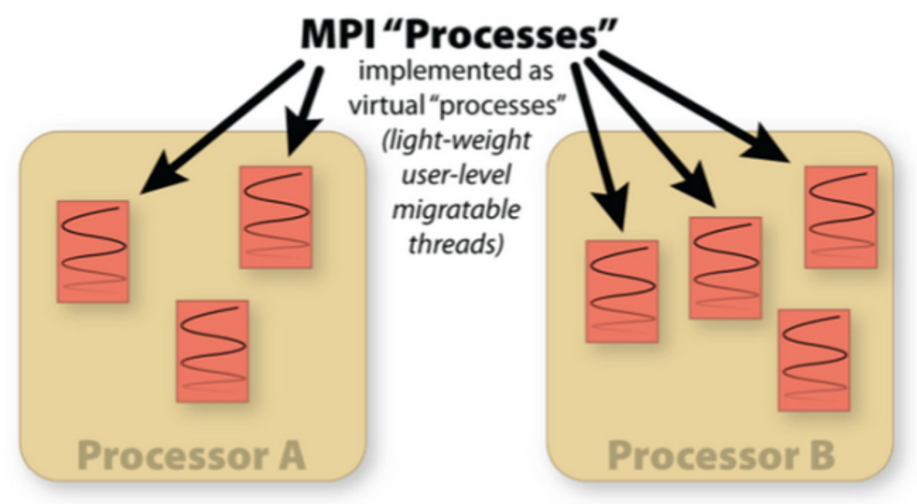
What Is Adaptive MPI?
AMPI is an MPI implementation on top of Charm++’s runtime system
Enables Charm++’s dynamic features for pre-existing MPI codes

Slide 3
Process Virtualization
AMPI virtualizes MPI “ranks,” implementing them as migratable user-level threads rather than OS processes
Benefits:
Communication/computation overlap
Cache benefits to smaller working sets
Dynamic load balancing
Lower latency messaging within a process
Disadvantages:
Global/static variables are shared by all threads in an OS process scope
Not an issue for new applications
AMPI provides support for automating this at compile/runtime
Ongoing work to fully automate

Slide 4
Dynamic Load Balancing
AMPI ranks are migratable across address spaces at runtime
Add a call to AMPI_Migrate(MPI_Info) in the application’s main iterative loop
Isomalloc memory allocator
No need for the user to explicitly write de/serialization (PUP) routines
Memory allocator migrates all heap data and stack transparently
Works on all 64-bit platforms except BGQ & Windows

Slide 5
Fault Tolerance
AMPI ranks can be migrated to persistent storage or in remote memories for fault tolerance
Storage can be Disk, SSD, NVRAM, etc.
The runtime uses a scalable fault detection algorithm and restarts automatically on a failure
Restart is online, within the same job
Checkpointing strategy is specified by passing a different MPI_Info to AMPI_Migrate()

Slide 6
Compiling & Running AMPI Programs
To compile an AMPI program:
charm/bin/ampicc –o pgm pgm.o
For migratability, link with: -memory isomalloc
For LB strategies, link with: –module CommonLBs
To run an AMPI job, specify the # of virtual processes (+vp)
./charmrun +p 1024 ./pgm
./charmrun +p 1024 ./pgm +vp 16384
./charmrun +p 1024 ./pgm +vp 16384 +balancer RefineLB

Slide 7
Case Study
LULESH proxy-application (LLNL)
Shock hydrodynamics on an unstructured mesh
With artificial load imbalance included to test runtimes
No mutable global/static variables: can run on AMPI as is
Replace mpicc with ampicc
Link with “-module CommonLBs –memory isomalloc”
Run with # of virtual processes and a load balancing strategy:
./charmrun +p 2048 ./lulesh2.0 +vp 16384 +balancer GreedyLB

Slide 8
AMPI Summary
AMPI provides the dynamic RTS support of Charm++ with the familiar API of MPI
Communication optimizations
Dynamic load balancing
Automatic fault tolerance
Checkpoint/restart
OpenMP runtime integration
See the AMPI Manual for more info

